Slide 1
Docker For Desktop
With:- Divyajeet Singh (Cloud Architect – Genpact)

Slide 2
Takeaways from the session
Physical Servers vs Virtual Machines vs Containers.
Why and how to use Docker.
Installing Docker for Desktop.
Kickstart your journey with Windows Containers.

Slide 3
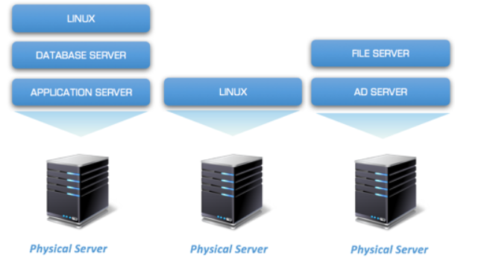
Notes:
CAPEX and OPEX.
One Server, One Application (if using same ports)

Slide 4
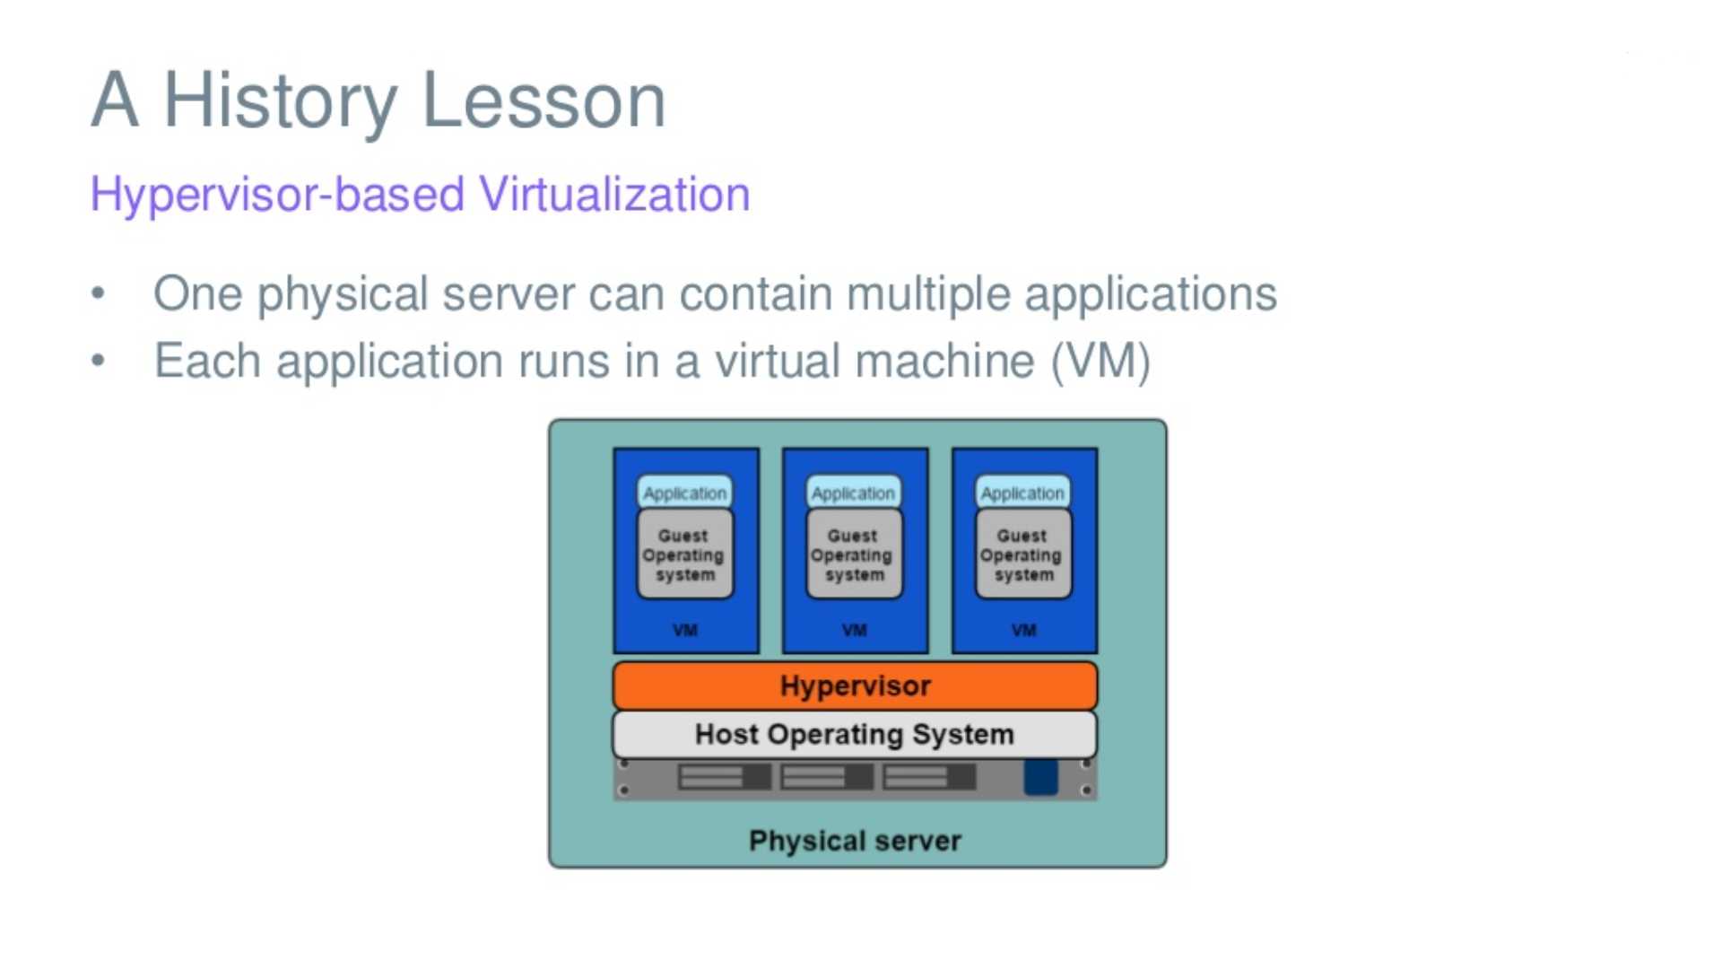
Notes:
Pros:-
One Server multiple applications.
Converted multiple servers as clusters.
Reduced the time to deliver.
Saved physical space / Electricity Requirements etc..
HA and FT.
Cons:-
Each OS needs it storage / License / Maintenance.
Faster to bring up than physical servers but lot slower than Containers.
Less consistency (Configurations / Dependencies) etc..

Slide 5
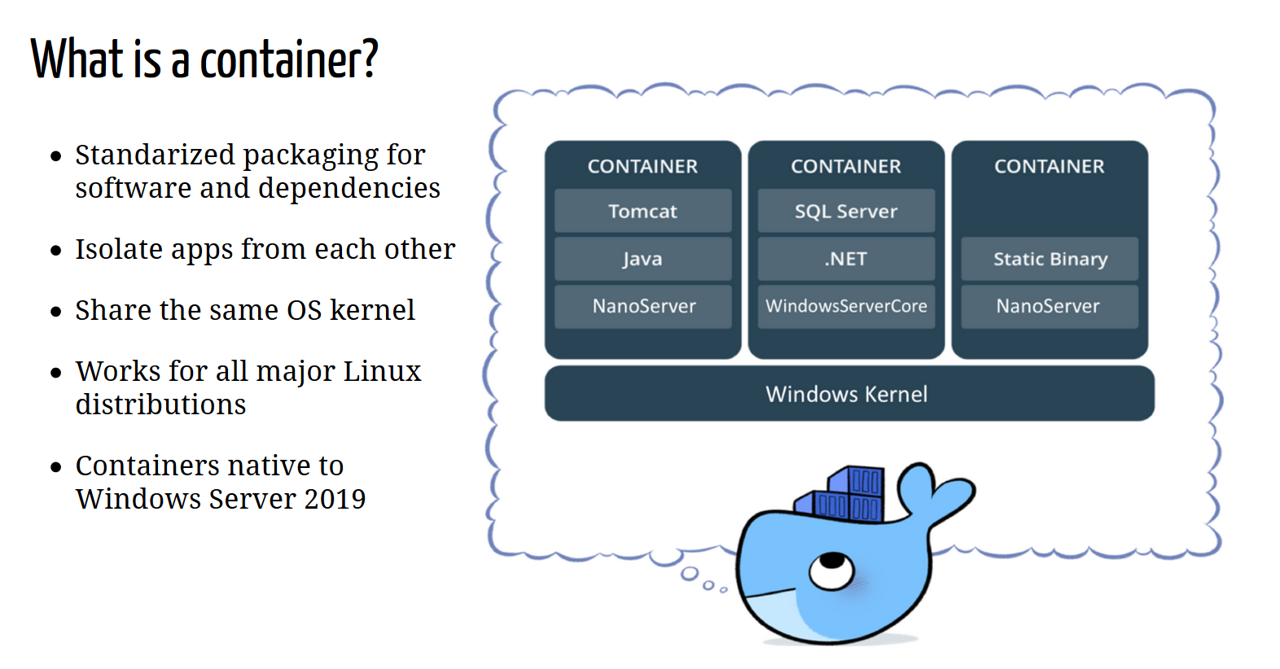
Notes:
Consistent experience on Dev Machine, On-Premises or Cloud.
What comes to you mind when we say monoliths?

Slide 6
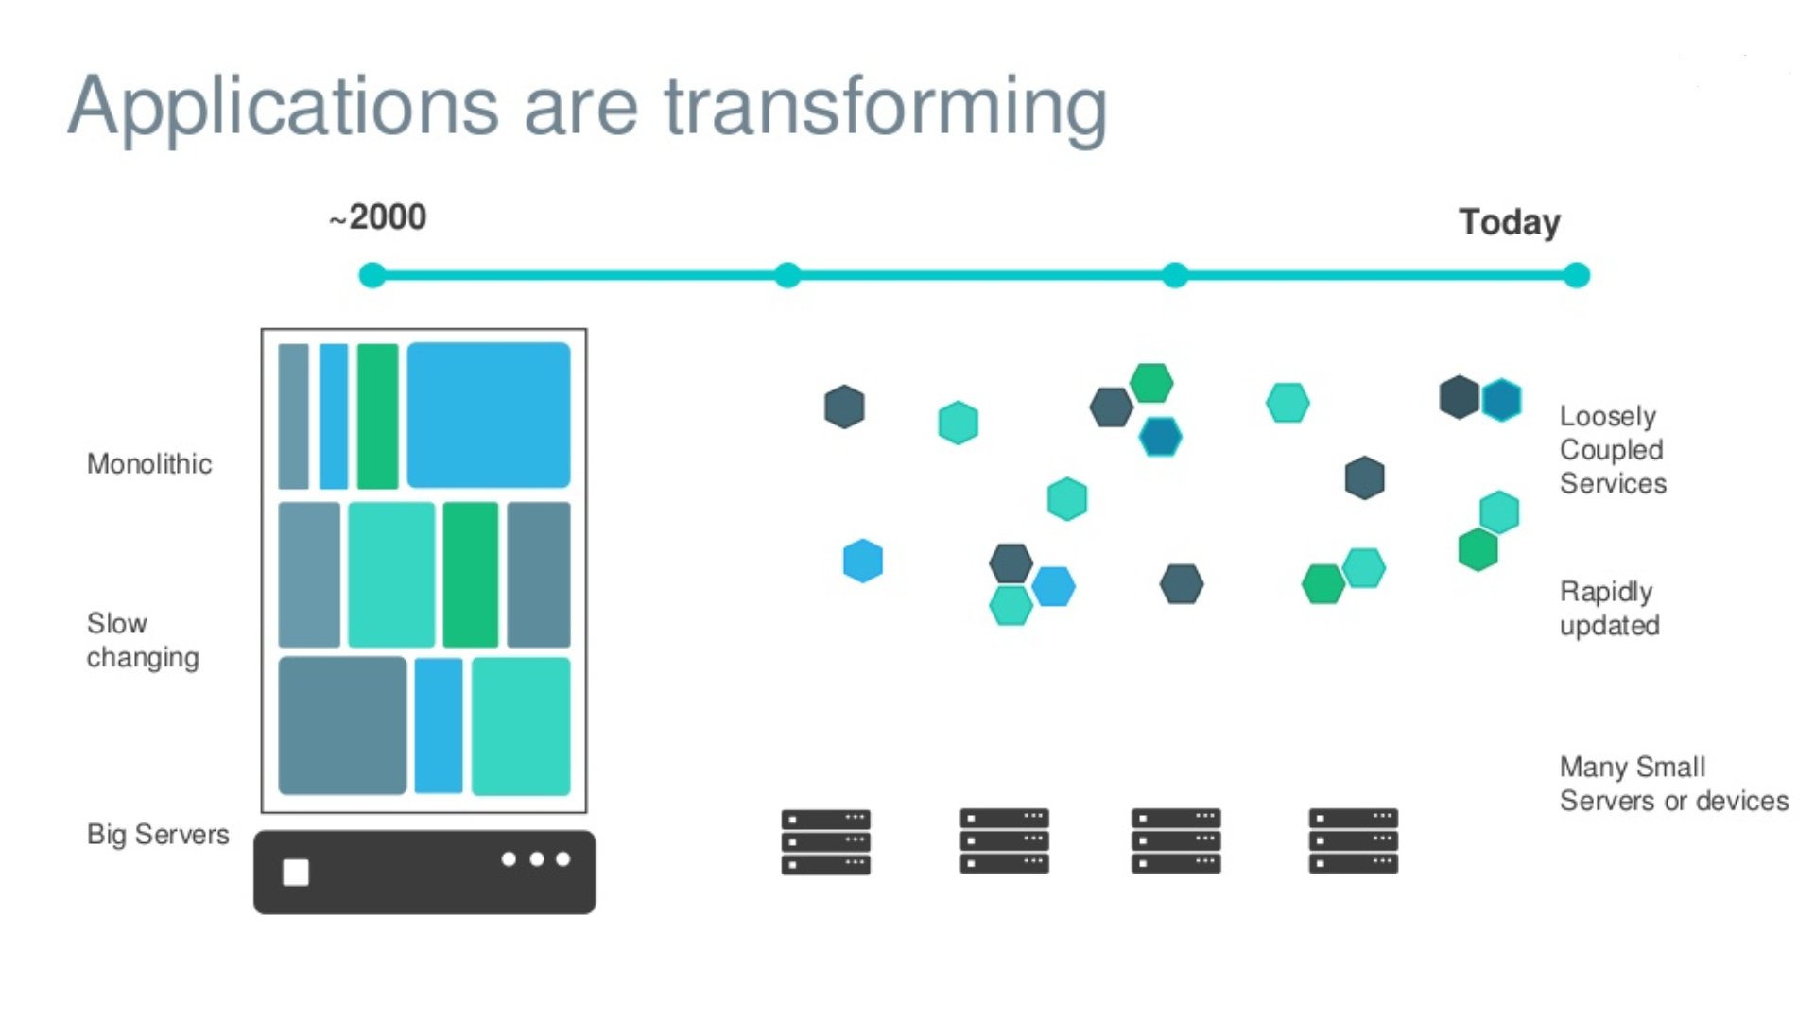

Slide 7
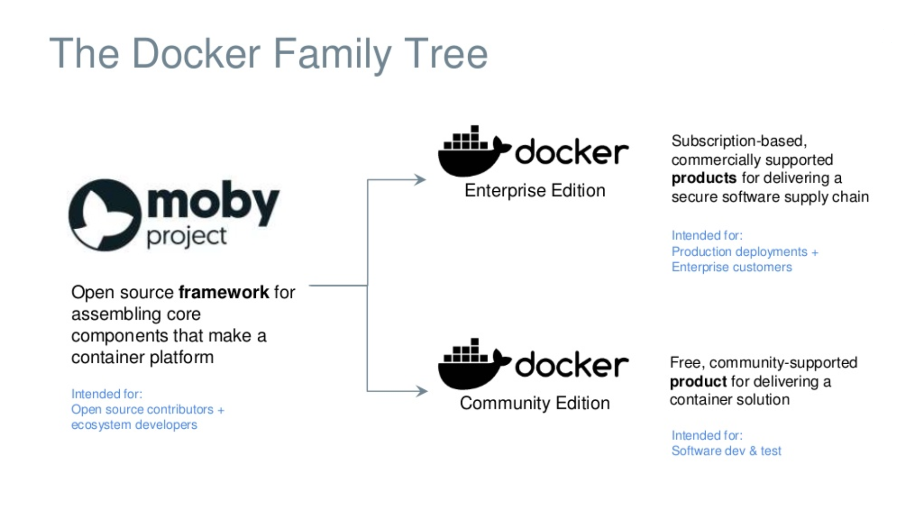

Slide 8
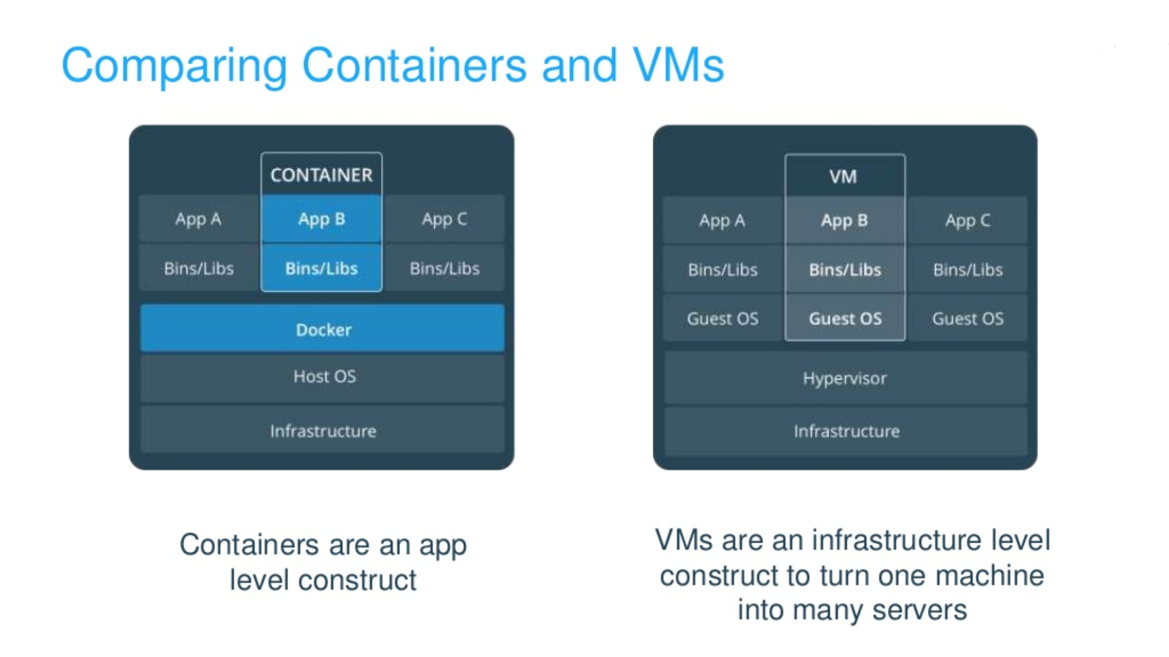

Slide 9
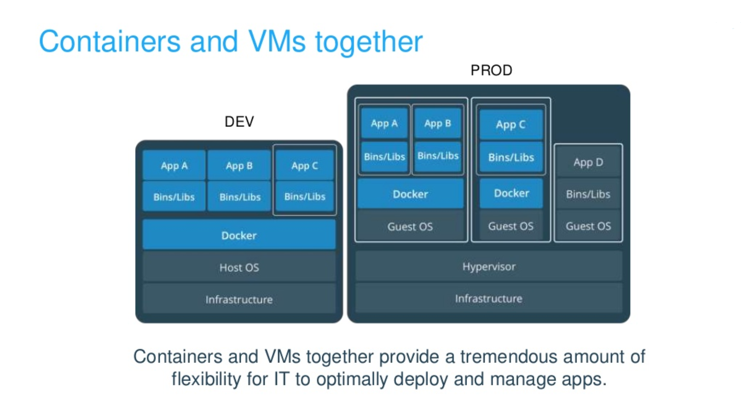

Slide 10
Docker for Desktop

Slide 11
Requirements
Docker Hub account.
Windows 10 (Pro, Enterprise or Education) Version 15063 and above.
Hyper-V and Containers Windows features must be enabled.
64-bit processor with SLAT (Intel i-Core Series).
4 GB RAM.
Virtualization enabled in BIOS.
https://www.docker.com/products/docker-desktop

Slide 12
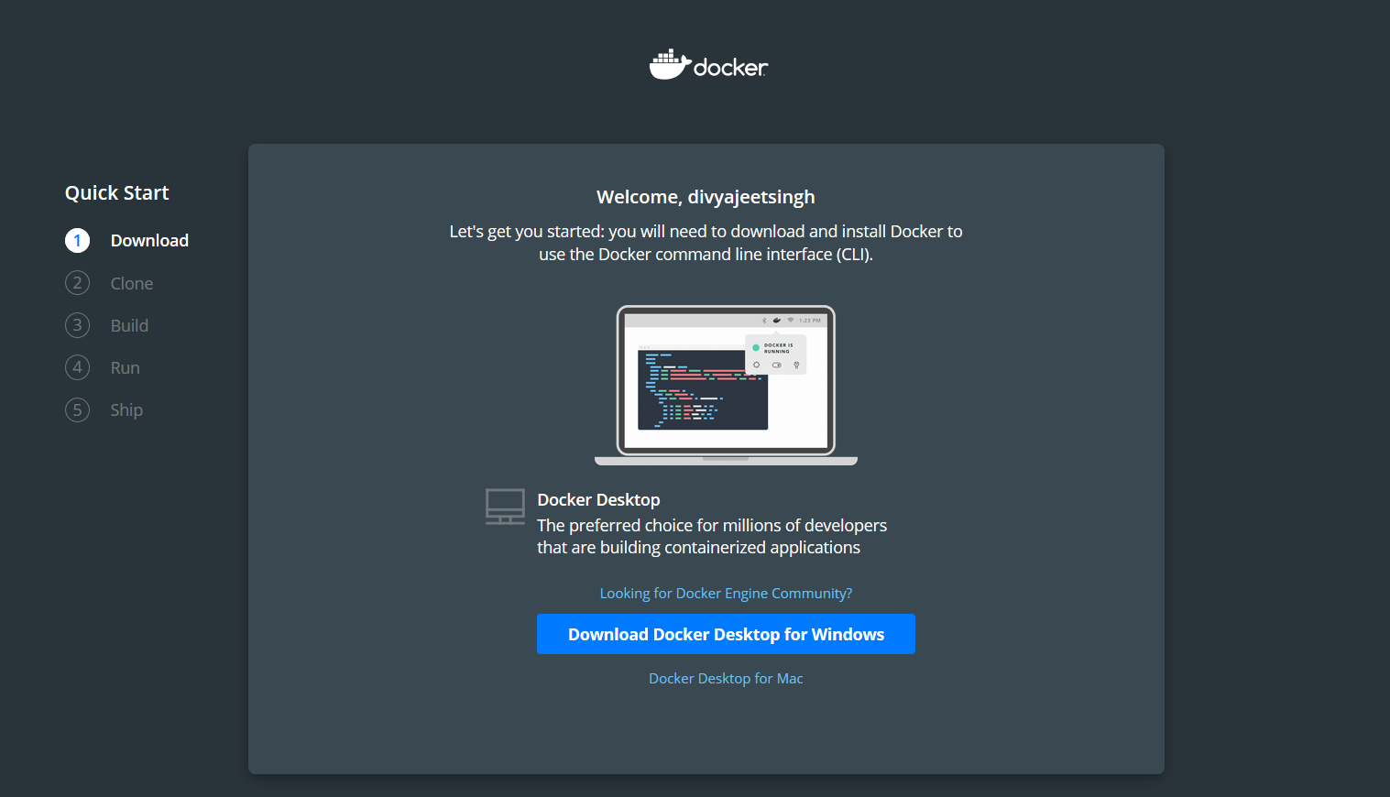

Slide 13
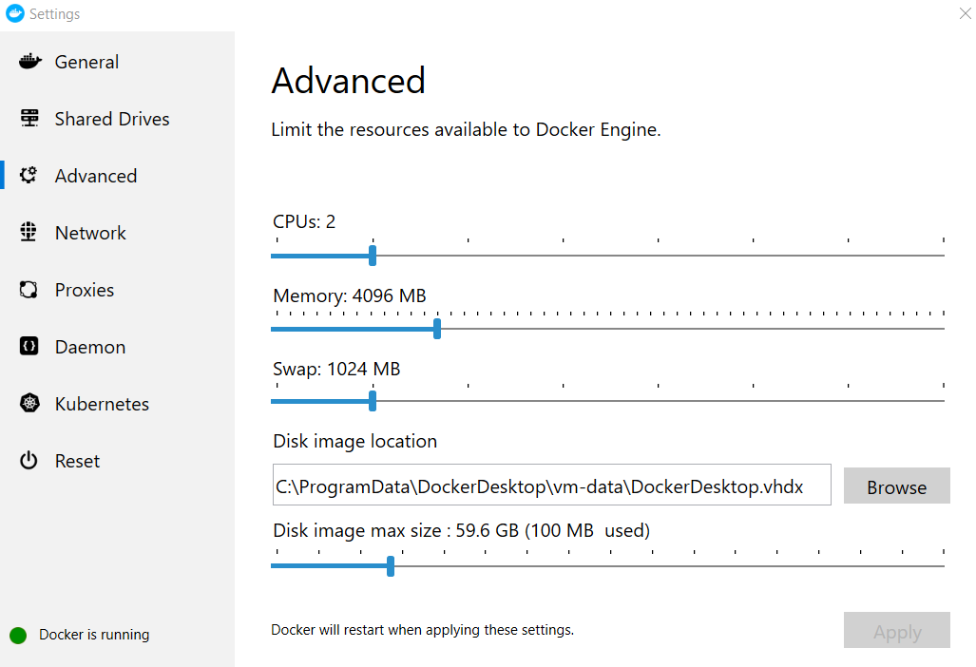

Slide 14
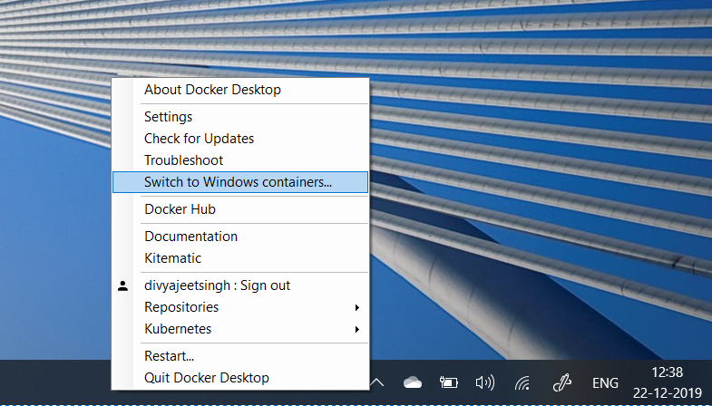
Switching to Windows Container - GUI

Slide 15
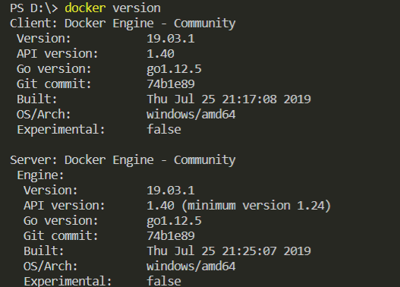
Switching to Windows Container - CMD
C:\Program Files\Docker\Docker\DockerCli.exe –SwitchWindowsEngine
Docker version

Slide 16

DEMO

Slide 17
Reference commands
Docker version
Docker pull mcr.microsoft.com/windows/servercore/iis
Docker images ls –a
Docker container run -d -p 8080:80 --name win-container mcr.microsoft.com/windows/servercore/iis
Docker container run -it –name powershell-container mcr.microsoft.com/powershell pwsh.exe
"C:\Program Files\Docker\Docker\DockerCli.exe –SwitchLinuxEngine“
Docker image ls –a
Docker pull nginx
Docker container run -d -p 8081:80 --name linux-container nginx

Slide 18

Demo of custom container using Dockerfile

Slide 19
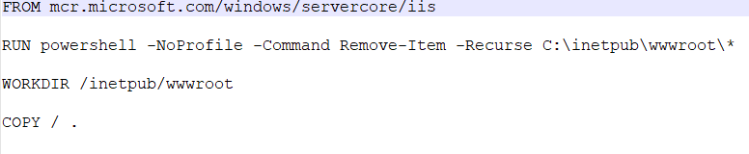
Reference commands
Dockerfile Screenshot
Create a Dockerfile
Docker image build -t my-image .
Run the container from the created image.
Docker container run -d -p 8082:80 --name div-iis my-image

Slide 20

Thank You !

